Slide 1
Assignment Problem
Operation Management

Slide 2
What is Assignment Problem?
Assignment problem is a special type of linear programming problem which deals with the allocation of the various resources to the various activities on one to one basis.
It does it in such a way that the cost or time involved in the process is minimum and profit or sale is maximum.

Slide 3
Algorithm for Square Matrix
For each row of the matrix, find the smallest element and subtract it from every element in its row.
Do the same (as step 1) for all columns.
Cover all zeros in the matrix using minimum number of horizontal and vertical lines.
Test for Optimality: If the minimum number of covering lines is equal to number of rows or columns, an optimal assignment is possible and we are finished. Else if, we haven’t found the optimal assignment, and must proceed to step 5.
Determine the smallest entry not covered by any line. Subtract this entry from each uncovered row, and then add it to each covered column. Return to step 3.

Slide 4
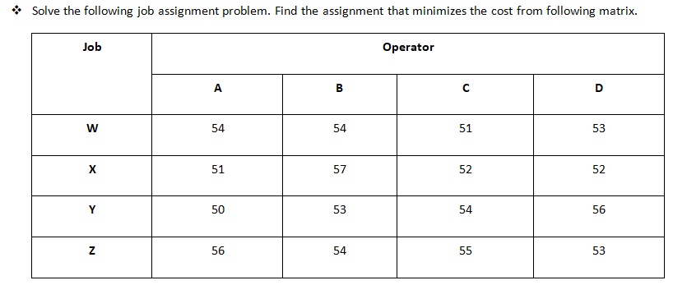

Slide 5
Minimum Row Value
3
3
0
2
51
0
6
1
1
51
0
3
4
6
50
3
1
2
0
53
ROW REDUCTION

Slide 6
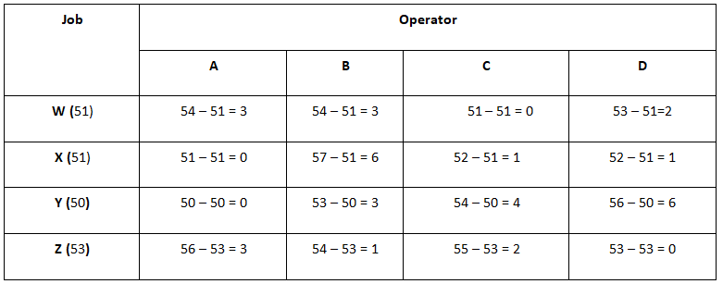

Slide 7
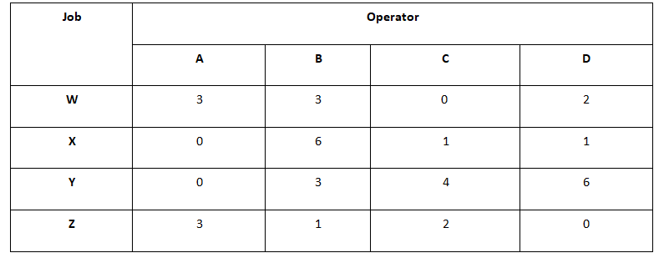
2
5
2
0
Min Column Value
0
1
0
0
COLUMN REDUCTION

Slide 8
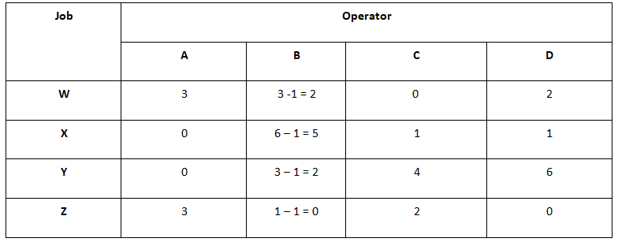

Slide 9
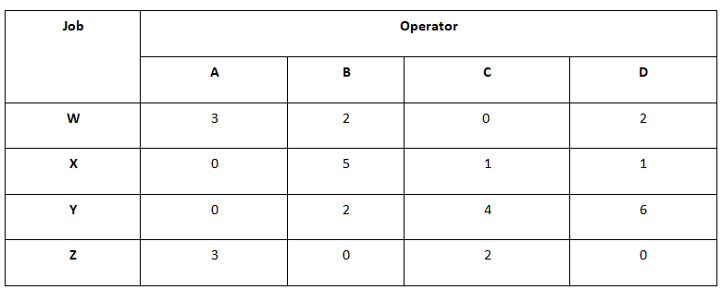
Number of Rows / Columns = 4 where as Number of Lines / Selected Zeros = 3
Since, Number of Lines / Selected Zeros ≠ Number of Rows / Columns, Optimal Solution is not reached yet.

Slide 10
3
1
0
1
0
4
1
0
0
1
4
5
4
0
3
0
Add: The selected minimum number to the elements in intersection
Subtract: The Selected minimum number to the elements which has not been touched by the line.
Copy: Copy the elements which has been touched by the line, as it is.

Slide 11
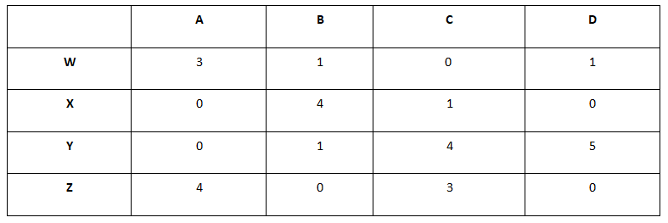
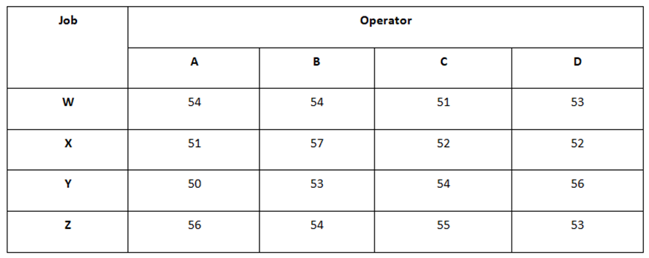

Slide 13
